Slide 1
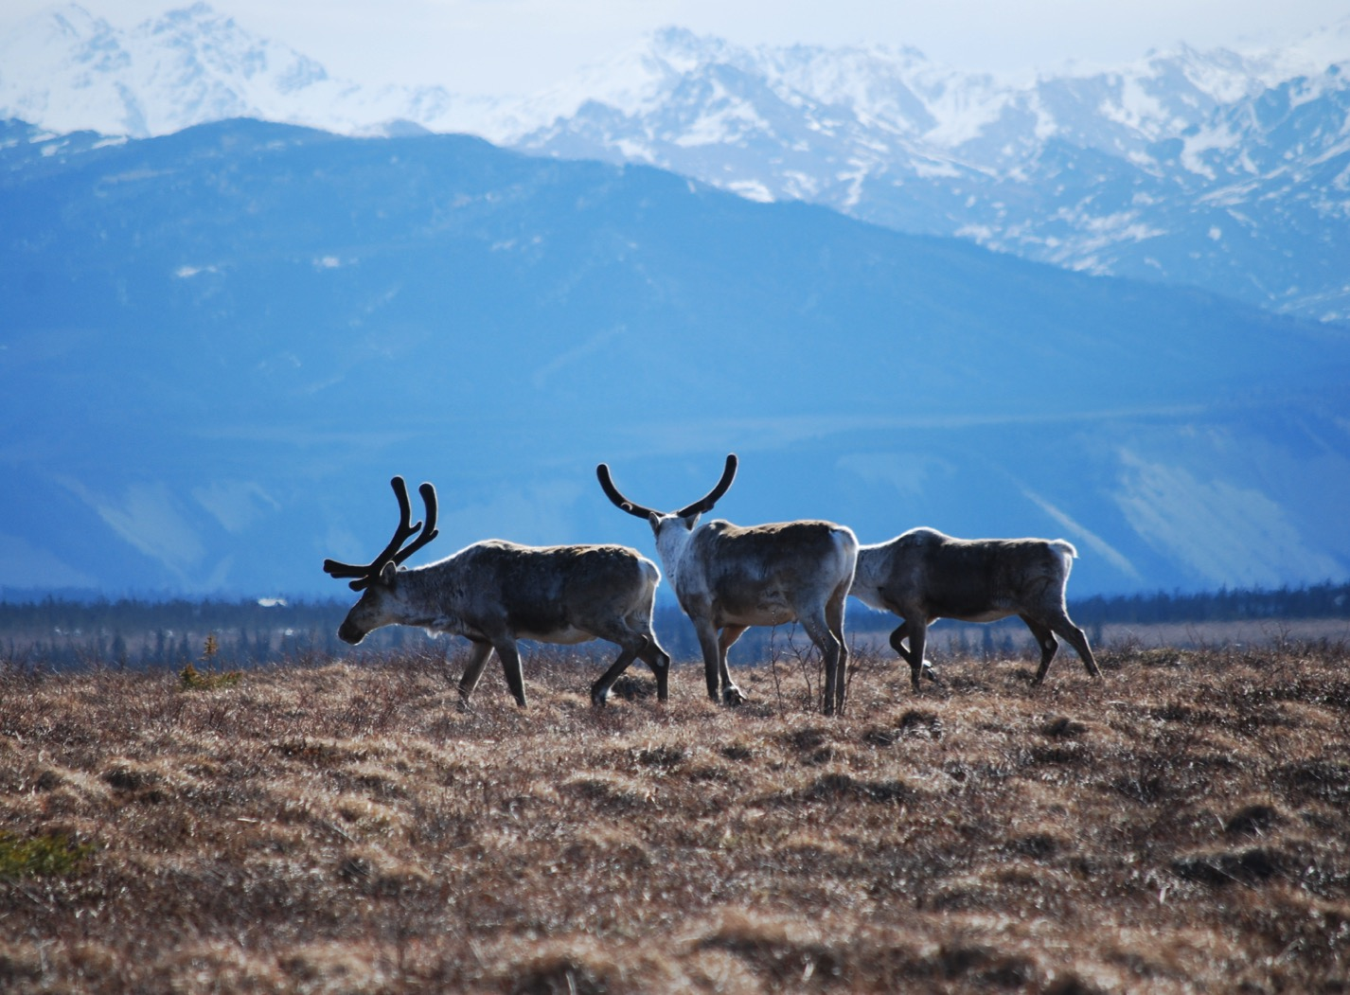
Arctic Boreal Vulnerability Experiment (ABoVE)
2017 ABoVE Airborne Campaign
18 July 2017 (DOY 199)
CFIS: Scotty Creek – Fort Smith
Charles Miller, Deputy Science Lead
Jet Propulsion Laboratory, California Institute of Technology
and the ABoVE Science Team For Hank Margolis, Eric Kasichke, Bruce Tagg
NASA HQ
2017

Slide 2
18 July 2017/DOY 199 Scotty Creek – Fort Smith
Daily Status:
CFIS/Twin Otter International N331AR
REPORT DATE: 18 July 2017
Current Status of Aircraft: GREEN
Current Status of CFIS: GREEN
Current Deployment Location: Fort Simpson NT (CYFS)
Crew: xxx, xxx, Drewry, Pavlick
Science Lead: D Drewry

Slide 3
18 July 2017/DOY 199 Scotty Creek – Fort Smith
Daily Summary:
Rosette pattern flown 2x over Scotty Creek flux towers – morning and afternoon
Clear sky conditions
Transit to Fort Smith NT

Slide 4
18 July 2017/DOY 199 72-Hour Look Ahead
All plans weather dependent
Wednesday 19 June 2017 (DOY 200):
Fort Smith – Saskatoon
Thursday 20 June 2017 (DOY 201):
BERMS/BOREAS area flux towers
Friday 21 June 2017 (DOY 202):
BERMS/BOREAS area flux towers

Slide 5
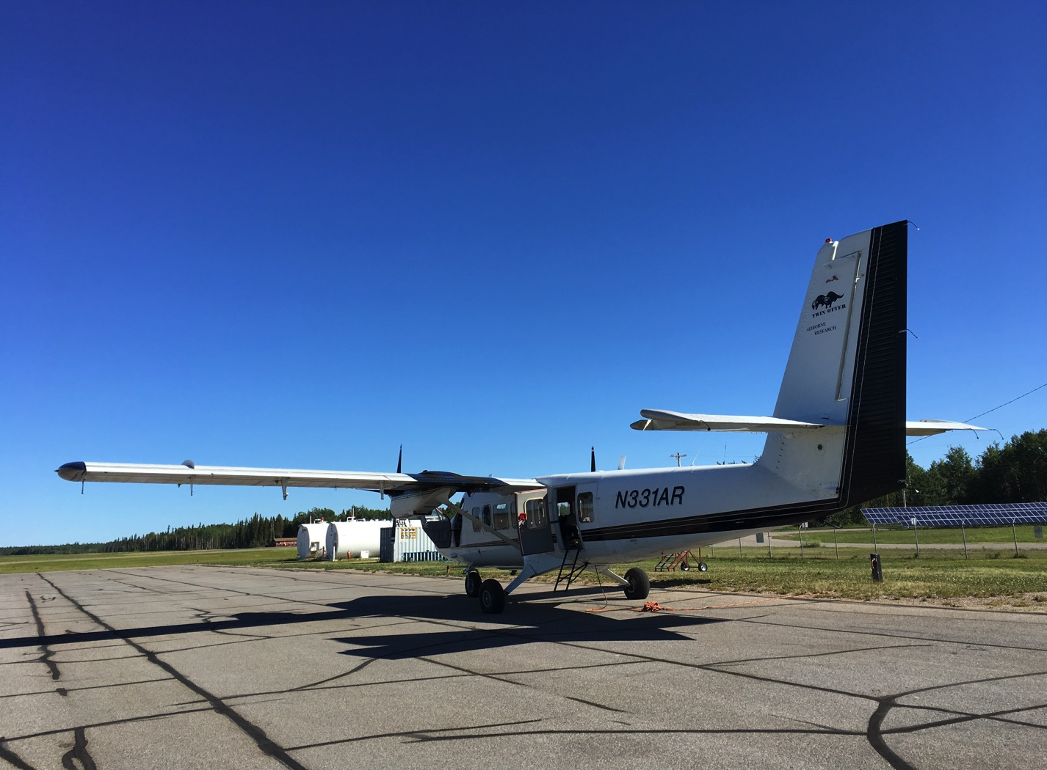
14 July 2017/DOY 195 Fairbanks – Inuvik
Perfect Day for Data – Fort Simpson NT (CYFS)
The CFIS Team and N331AR prepare to depart Fairbanks for Inuvik

Slide 6
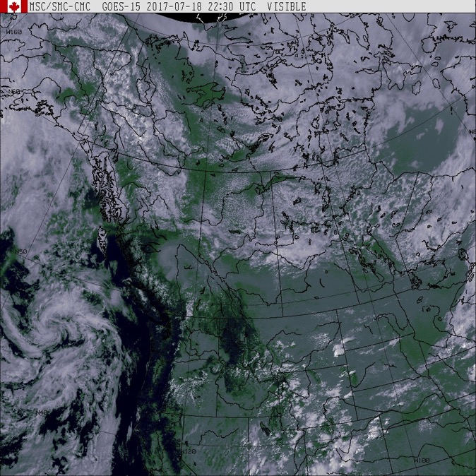
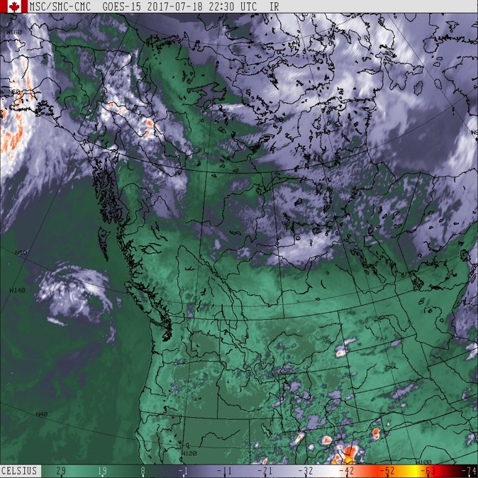
18 July 2017/DOY 199 Scotty Creek – Fort Smith
GOES West IR
2230Z
GOES West Vis
2230Z
Mostly clear in the Scotty Creek/Fort Simpson NT area
Increasing afternoon clouds south of Great Slave Lake

Slide 7
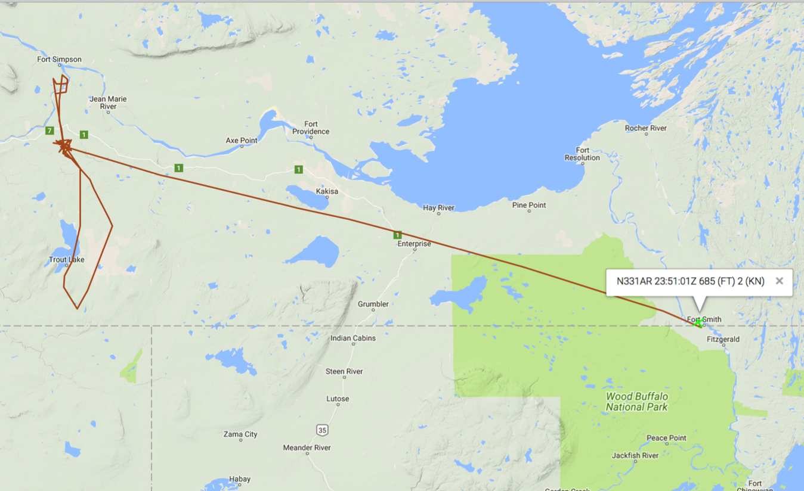
18 July 2017/DOY 199 Scotty Creek – Fort Smith
As-flown lines
Notes:
2x rosettes flown over Scotty Creek flux towers

Slide 8
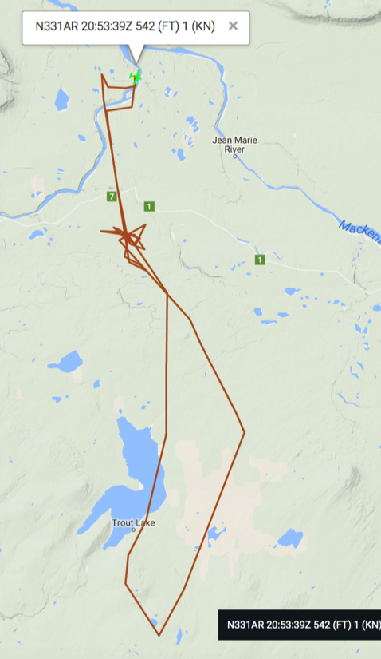
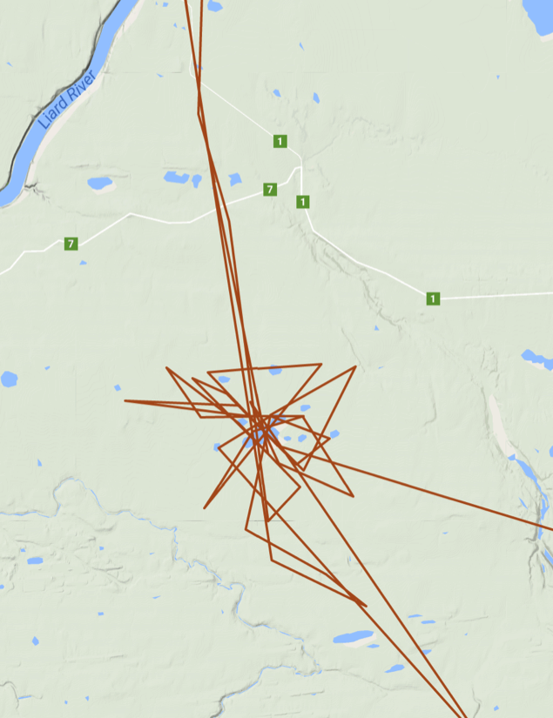
18 July 2017/DOY 199 Scotty Creek – Fort Smith
As-flown lines (detail):
Scotty Creek Flux Towers
As-flown lines
Sortie #1
Notes:
2x rosettes flown over Scotty Creek flux towers

Slide 9
18 July 2017/DOY 199 Scotty Creek – Fort Smith
CFIS Quick-look products – to be delivered
Notes:
These 3 lines cover NGEE-Arctic SewPen field sites
Note the rugged terrain and fluvial tracings of the vegetation

